Slide 1
Chapter 7 Design Concepts and Principles
Design is a meaningful engineering representation of something that is to be built.
Design focuses on four major areas:
Data
Architecture
Interfaces
Components

Slide 2
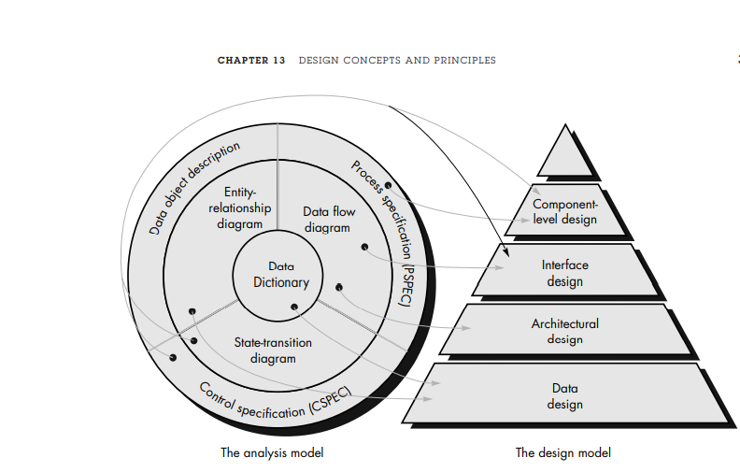
Translating the analysis model into a software design

Slide 3
Translating the analysis model into a software design
The data design transform the information domain model created during analysis into the data structures.
Data objects and relationships defined in the ERD and the detailed data content depicted in the data dictionary provide the basis
The Architectural design defines the relationship between major structural elements of the software.
The interface design describes how the software communicates within systems .

Slide 4
Translating the analysis model into a software design
The component level design transform structural elements of the software architecture into a procedure description of software components.
Information obtained from PSPEC, CSPEC serves as the basis for the component design

Slide 5
Data Design
Data design sometimes referred to as data architecting creates a model of data and/or information that is represented at a high level of abstraction the customer/user’s view of data.
This data model is then refined into progressively more implementation-specific representations that can be processed by the computer-based system.

Slide 6
Architectural Design
The software architecture of a program or computing system is the structure or structures of the system, which comprise software components, the externally visible properties of those components, and the relationships among them.

Slide 7
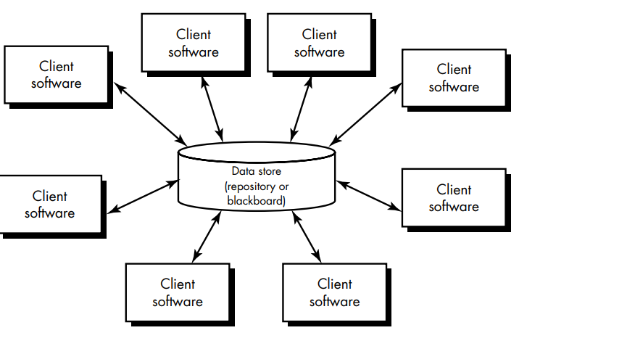
Architectural Design

Slide 8
Architectural Design
Who does it? Although a software engineer can design both data and architecture, the job is often allocated to specialists when large, complex systems are to be built. A database or data warehouse designer creates the data architecture for a system. The “system arc

Slide 9
Interface Design
User interface design creates an effective communication medium between a human and a computer.
Following a set of interface design principles, design identifies interface objects and actions and then creates a screen layout that forms the basis for a user interface prototype.
Who does it?
A software engineer designs the user interface by applying an iterative process that draws on predefined design principles

Slide 10
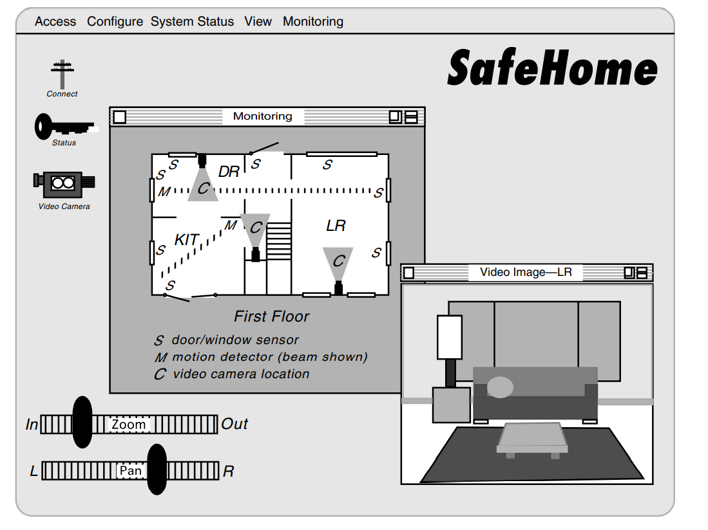
Interface Design

Slide 11
Component Design
Component-level design, also called procedural design, occurs after data, architectural, and interface designs have been established.
The intent is to translate the design model into operational software.
But the level of abstraction of the existing design model is relatively high, and the abstraction level of the operational program is low
The translation can be challenging, opening the door to the introduction of subtle errors that are difficult to find and correct in later stages of the software process

Slide 12
Component Design
Who does it?
A software engineer performs component-level design.

Slide 13
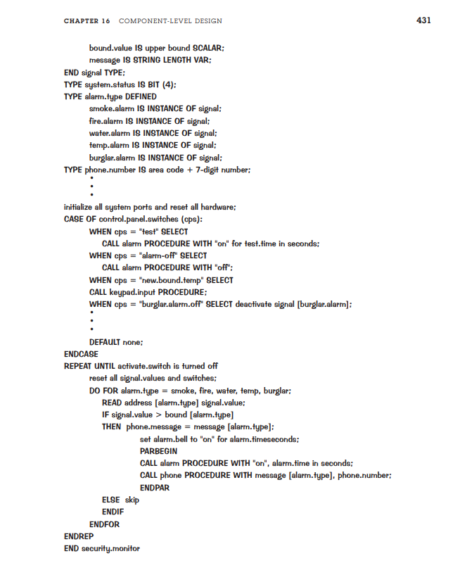
Component Design

Slide 14
Design Process
Software design is an iterative process through which requirements are translated into a “blueprint” for constructing the software.
Initially, the blueprint depicts a holistic view of software.
That is, the design is represented at a high level of abstraction— a level that can be directly traced to the specific system objective and more detailed data, functional, and behavioral requirements.
As design iterations occur, subsequent refinement leads to design representations at much lower levels of abstraction.
These can still be traced to requirements, but the connection is more subtle

Slide 15
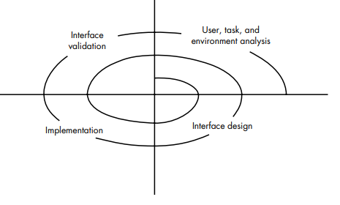
Design Process

Slide 16
Design Guidelines
Design should exhibit an architectural structure .
A design should be modular → logically , function& Sub functions
A design should contain distinct representation of data, architecture, interfaces and components
A design should lead to component that exhibit independent functional characteristics
A design should lead to interfaces that reduce the complexity

Slide 17
DESIGN PRINCIPLES
The design process should not suffer from “tunnel vision” – alternative approach
The design should be traceable to the analysis model.
The design should not reinvent the wheel.-- > already exist (new ideas)
The design should “minimize the intellectual distance” between the software and the problem
The design should exhibit uniformity and integration.– rules and format should be defined for a design team
The design should be structured to accommodate change.
The design should be structured to degrade gently, even when aberrant data, events, or operating conditions are encountered.

Slide 18
Design Principles
• Design is not coding, coding is not design
The design should be reviewed to minimize conceptual errors

Slide 19
DESIGN CONCEPTS
A set of fundamental software design concepts has evolved over the past four decades
Each helps the software engineer to answer the following questions:
What criteria can be used to partition software into individual components?
How is function or data structure detail separated from a conceptual representation of the software?
What uniform criteria define the technical quality of a software design?

Slide 20
Design Concept
Abstraction
Data abstraction → Door
Procedural abstraction → Open ()
Control abstraction : → synchronization semaphore

Slide 21
Design Concept
Refinement
There is a tendency to move immediately to full detail, skipping the refinement steps.
This leads to errors and omissions and makes the design much more difficult to review.
Perform stepwise refinement for the design

Slide 22
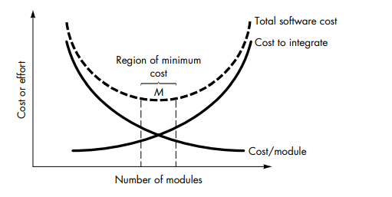
Design Concept
Modularity
Don’t over modularize.
The simplicity of each module will be overshadowed by the complexity of integration.

Slide 23
Design Concept
Modularity
Criteria that enable effective modular system:
Modular decomposability:
Modular composability:
Modular understandability: module can be understood as a standard alone unit (without reference to other modules)
Modular continuity: small change in the system requirement result in changes to individual modules, rather than systemwide change
Modular protection: able to handle aberrant condition

Slide 24
Design Concept
Software Architecture
Software architecture implies to “the overall structure of the software
Design concept provides the conceptual integrity for a system
Software architecture provides the hierarchical structure of program components

Slide 25
Design Concept
Software Architecture
architectural design can be represented using one or more of a number of different models .
Structural models: represents organized collection of program components
Framework models :High level abstraction by identifying reusability
Dynamic models: address the behavioral aspects of the program
Process models: focus on the design of the business or technical process
functional models: represents functional hierarchy
A number of different architectural description languages (ADLs) have been developed to represent these models .

Slide 26
Control Hierarchy
Control hierarchy, also called program structure, represents the organization of program components and implies a hierarchy of control.
It does not represent procedural aspects of software such as sequence of processes, occurrence or order decisions
The most common is the treelike diagram that represents hierarchical control for call and return architectures.

Slide 27
Control Hierarchy
Depth and width provide an indication of the number of levels of control and overall span of control
Fan-out is a measure of the number of modules that are directly controlled by another module.
Fan-in indicates how many modules directly control a given module.

Slide 28
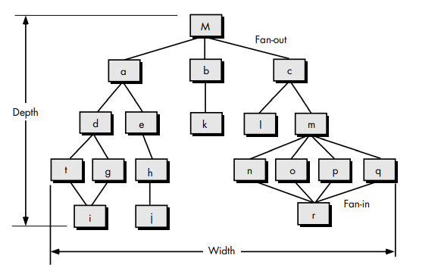
Control Hierarchy

Slide 29
Control Hierarchy
The control relationship among modules is expressed in the following way:
A module that controls another module is said to be superordinate to it,
conversely, a module controlled by another is said to be subordinate to the controller .
module M is superordinate to modules a, b, and c.
Module h is subordinate to module e and is ultimately subordinate to module M.

Slide 30
Structural Partitioning
If the architectural style of a system is hierarchical, the program structure can be partitioned both horizontally and vertically.
horizontal partitioning defines separate branches of the modular hierarchy for each major program function.
Control modules, represented in a darker shade are used to coordinate communication between and execution of the functions.
The simplest approach to horizontal partitioning defines three partitions—input, data transformation and output.
Partitioning the architecture horizontally provides a number of distinct benefits

Slide 31
Structural Partitioning
software that is easier to test
• software that is easier to maintain
• propagation of fewer side effects
• software that is easier to extend

Slide 32
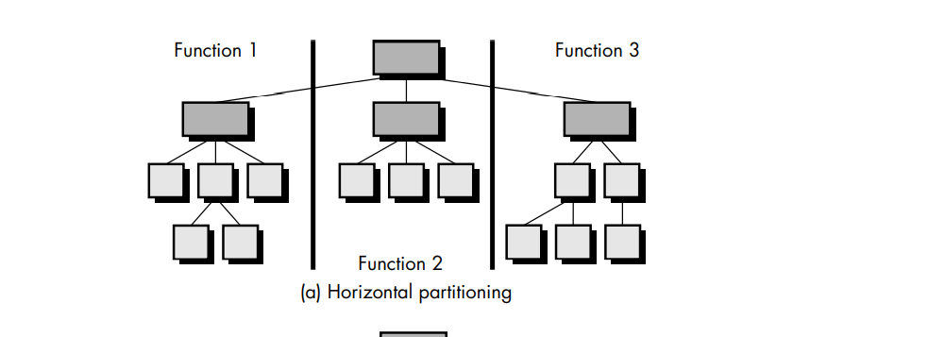
Horizontal partitioning

Slide 33
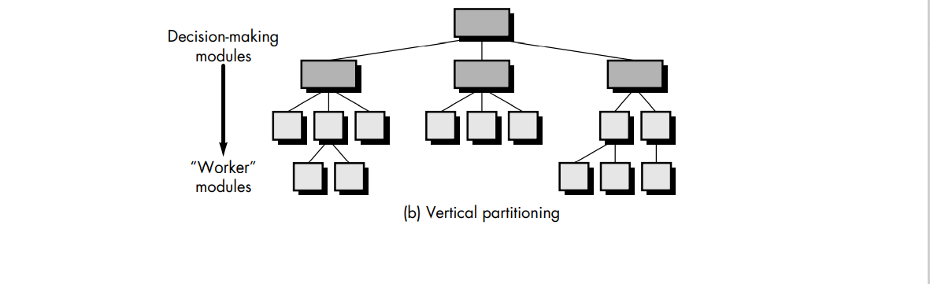
Vertical Partitioning

Slide 34
Vertical Partitioning
often called factoring
control (decision making) and work should be distributed top-down in the program structure.
Top level modules should perform control functions and do little actual processing work.
Modules that reside low in the structure should be the workers, performing all input, computation, and output tasks.

Slide 35
Vertical Partitioning
“Worker” modules tend to change more frequently than control modules.
By placing the workers low in the structure, side effects (due to change) are reduced.

Slide 36
Vertical Partitioning
change in a control module will have a higher probability of propagating side effects to modules that are subordinate to it.
A change to a worker module, given its low level in the structure, is less likely to cause the propagation of side effects.
changes to computer programs revolve around changes to input, computation or transformation, and output.
The overall control structure of the program (i.e., its basic behavior is far less likely to change).
For this reason vertically partitioned structures are less likely to be susceptible to side effects
when changes are made and will there fore be more maintainable—a key quality fact

Slide 37
Data Structure
Data structure is a representation of the logical relationship among individual elements of data.
Because the structure of information will invariably affect the final procedural design,
data structure is as important as program structure to the representation of software architecture.
the organization, methods of access, degree of associativity, and processing alternatives for information.

Slide 38
Data Structure
A scalar item is the simplest of all data structures.
a scalar item represents a single element of information
The size and format of a scalar item may vary within bounds that are dictated by a programming language.
For example, a scalar item may be a logical entity one bit long, an integer or floating point number that is 8 to 64 bits long, or a character string that is hundreds or thousands of bytes long.
When scalar items are organized as a list or contiguous group, a sequential vector is formed.

Slide 39
Data Structure
When the sequential vector is extended to two, three, and ultimately, an arbitrary number of dimensions, an n-dimensional space is created.
The most common n-dimensional space is the two-dimensional matrix. In many programming languages, an n-dimensional space is called an array.

Slide 40
Software Procedure
Program structure defines control hierarchy without regard to the sequence of processing and decisions.
Software procedure focuses on the processing details of each module individually.
Procedure must provide a precise specification of processing, including sequence of events, exact decision points, repetitive operations, and even data organization and structure.

Slide 41
Information Hiding
The concept of modularity leads every software designer to a fundamental question: "How do we decompose a software solution to obtain the best set of modules?“
The principle of information hiding suggests that modules be characterized by design decisions that hides from all others.
modules should be specified and designed so that information (procedure and data) contained within a module is inaccessible to other modules that have no need for such information.

Slide 42
Effective Modular Design
Functional Independence:
Functional independence is achieved by developing modules with "single-minded" function
Functional Independence removes the excessive interaction with other modules

Slide 43
Coupling and Cohesion
Cohesion: Cohesion is the indication of the relationship within module.
It is concept of intra-module.
Cohesion has many types but usually highly cohesion is good for software.

Slide 44
Coupling and Cohesion
Coupling is also the indication of the relationships between modules.
It is concept of Inter-module.
Coupling has also many types but usually low coupling is good for software.

Slide 45
Coupling and Cohesion
While you are designing the system always focus on low coupling and high cohesion.

Slide 46
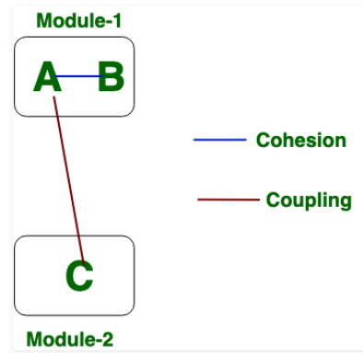
Coupling and Cohesion

Slide 47
Architecture Design
ARCHITECTURAL STYLES
When a builder uses the phrase “center hall colonial” to describe a house, most people familiar with houses in the United States will be able to conjure a general image of what the house will look like and what the floor plan is likely to be

Slide 48
Architecture Patterns/ Styles
Data-centered architectures
A data store resides at the center of this architecture
Data is accessed frequently by other components that update, add, delete, or otherwise modify data within the store.
Client software accesses a central repository.

Slide 49
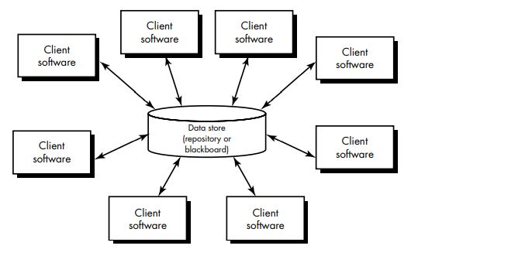
Data Center Architecture

Slide 50
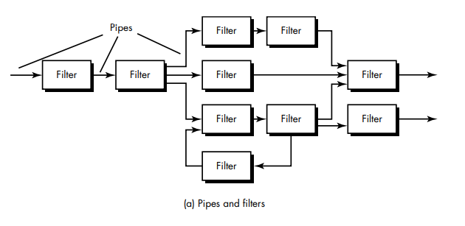
Data Flow Architecture

Slide 51
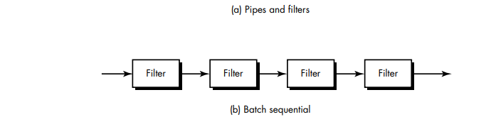
Data Flow Architecture

Slide 52
Data Flow Architecture
This architecture is applied when input data are to be transformed through the series of computational components into output.
Pipe and filter pattern is used for the DATA FLOW ARCHITECTURE.
Each processing step is encapsulates in a filter component
Data is passed through the pipe between adjacent filters.
If the data flow degenerates into a single line of transformation it is termed as sequential
This pattern accepts a batch of data and applied series of sequential components.

Slide 53
Call and return architecture
This architecture helps designer to modify and scale program easily.
A number of substyles exist within this category.
Main Program and Subprogram architecture :-
Remote procedure call architecture:

Slide 54
Object Oriented Architecture
Communication and co-ordination between components is accomplished by message passing.

Slide 55
Layered Architecture
A number of different layers are defined.
Each accomplishing operations that progressively become closer to the machine instruction set.
At the outer layers, components service the user interface operations.
At the inner layer, components perform operating system interfacing.

Slide 56
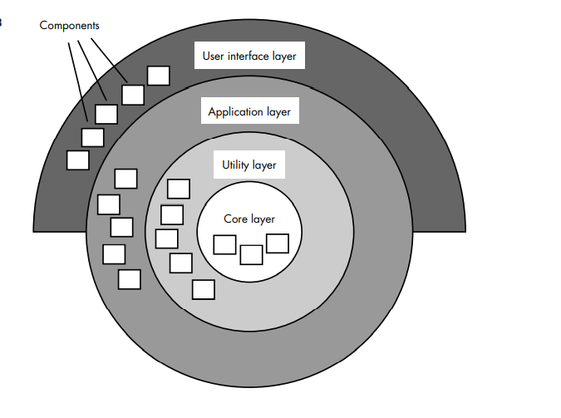
Layered Architecture

Slide 57
DATA DESIGN
Data Design creates a model of data that is represented at a high level of abstraction.
This data model is then refined into progressively more implementation specific representation that can be processed by the computer-based system.
Data Design plays an important role in following cases
At the program component level
At the application data design
At the business level

Slide 58
Data Modeling, Data Structure, Databases and Data Ware house
The data objects defined during the software requirements analysis are modeled using ERD and Data Dictionary.
Data Design activity translate these elements of the model into data structures.
Data warehouse is a separate data environment that is not directly integrated with day-to day application but encompasses all data used by a business
Data warehouse is a large, independent database that serve the set of applications required by a business.

Slide 59
Principles of Data Design
Set of Principles for the data Design
The systematic analysis principles should be applied to the data.
All data structures and the operations to be performed on each should be identified.
A data dictionary should be established

Slide 60
Principles of Data Design
4. The representation of data structures should be known only to those modules that must make direct use of the data
5.. A library of useful data structures and the operations should be developed.
6. A software design and programming language should support the specification and realization of abstract data types.

